Slide 1
Project Title
University HUB

Slide 2
Purpose of the Project
The aim of University HUB is to computerize Online admission process for higher education courses. Its basic objectives are to extend their reach to geographically scattered students, reducing time in activities, centralized data handling and paperless admission with reduced manpower. Its other factors are cost cutting, operational efficiency, consist view of data and integration with other institutions. Main challenges are effectively sync internal and external operations in such a manner that job can be finished within time limit and integration with different agencies on an agreed upon common data format.

Slide 3
Introduction
Education helps to stimulate our minds and mold inquisitive minds into intellectuals. Higher learning takes the intellect to the next level, providing a deeper understanding of the world around us. Use the education and higher learning resources below to learn more about your world, its education systems, and its benefits of higher learning. Get useful information about higher education, career planning and training, distance education and much more.
With environmental awareness on the rise, so many resources are now available to help transition your school to a greener place. Below are over following ways to make your school a more earth-friendly campus. Recruit helpers and get creative to make the job fun. Those are Educate, Become Aware, Reduce, Reuse, Recycle, Put Ideas into Action. The most important way to move your school towards positive changes for the environment is by educating. Once students and teachers alike become more informed and aware, the necessary changes will be easier to implement and will hold more promise for staying in place.

Slide 4
Problem Identification
There are no registrations and no profile management.
Mismanagement of files due to records and excel sheets.
Searching of colleges is very difficult.
Authentication is very less due to less security to the data.

Slide 5
Providing solution for the problem
Easy of access due to registration because only registered members can only have accessibility.
Authentication is provided.
Centralized database is provided.
No security problem.
Easy to search .

Slide 6
Preferred Technologies
Windows XP Operating System
My Eclipse 8.6
Oracle 10g
IIS Web Server
Internet Explorer 6 or 7

Slide 7
Hard Ware Requirements
Pentium IV System with 2.8 GHZ Processor
1 GB RAM
40 GB Hard Disk

Slide 8
Software Requirement Specification
SDLC Methodologies
Sdlc consists of 5 phases
Requirement and analysis
Design
coding
Testing
Implementation and maintenance

Slide 9
Spiral Model
The spiral model is similar to the incremental model, with more emphasis placed on risk analysis. The spiral model has four phases: Planning, Risk Analysis, Engineering and Evaluation. A software project repeatedly passes through these phases in iterations (called Spirals in this model). The baseline spiral, starting in the planning phase, requirements is gathered and risk is assessed. Each subsequent spiral builds on the baseline spiral. Requirements are gathered during the planning phase. In the risk analysis phase, a process is undertaken to identify risk and alternate solutions. A prototype is produced at the end of the risk analysis phase.

Slide 10
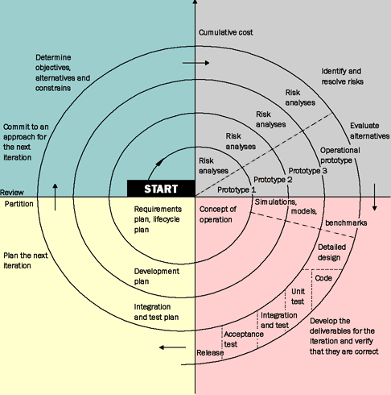
Diagram of Spiral Model

Slide 11
MVC Architecture
The standard architecture for project design is MVC architecture.
The standard architecture for project development is LC-RP(loosly coupled runtime polymorphism) architecture.
MVC Definition:
It stands for Model View Controller.MVC is a standard architectural design pattern for developing World Wide Web apps.The central idea behind MVC is code reusability and separation of roles of code development.

Slide 12
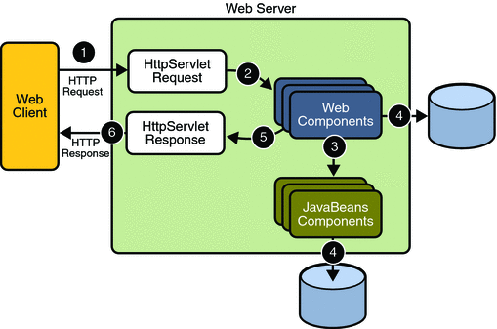
Architecture Diagram

Slide 13
Number of Modules
Type Your Modules Here
For Example
Admin/Data Manager
Student
Counselors
Security and authentication
Results , news ,magazine, mails
Reports

Slide 14
Admin Authentication
It provides the information’s about the various college’s and course’s .
It add the councilor information related to the college
It views the information or feedback from the general users about the quality of counseling and also providing some information to the user.
It views the discussion forums and gives the detailed suggestions about the forums.
It adds the subject details to the each course.
It provides online help to all students.
It provide syllabus to each course.

Slide 15
Student Authentication
It views all the details of university
It views all the course details
It views the subject details
It views the college details
It start discussion forums
It views the counselor tips for the discussion topics
It gives some response to the administrator or counselor
It asks offline/online requests to counselor
Fill admission form
Download allotment letter

Slide 16
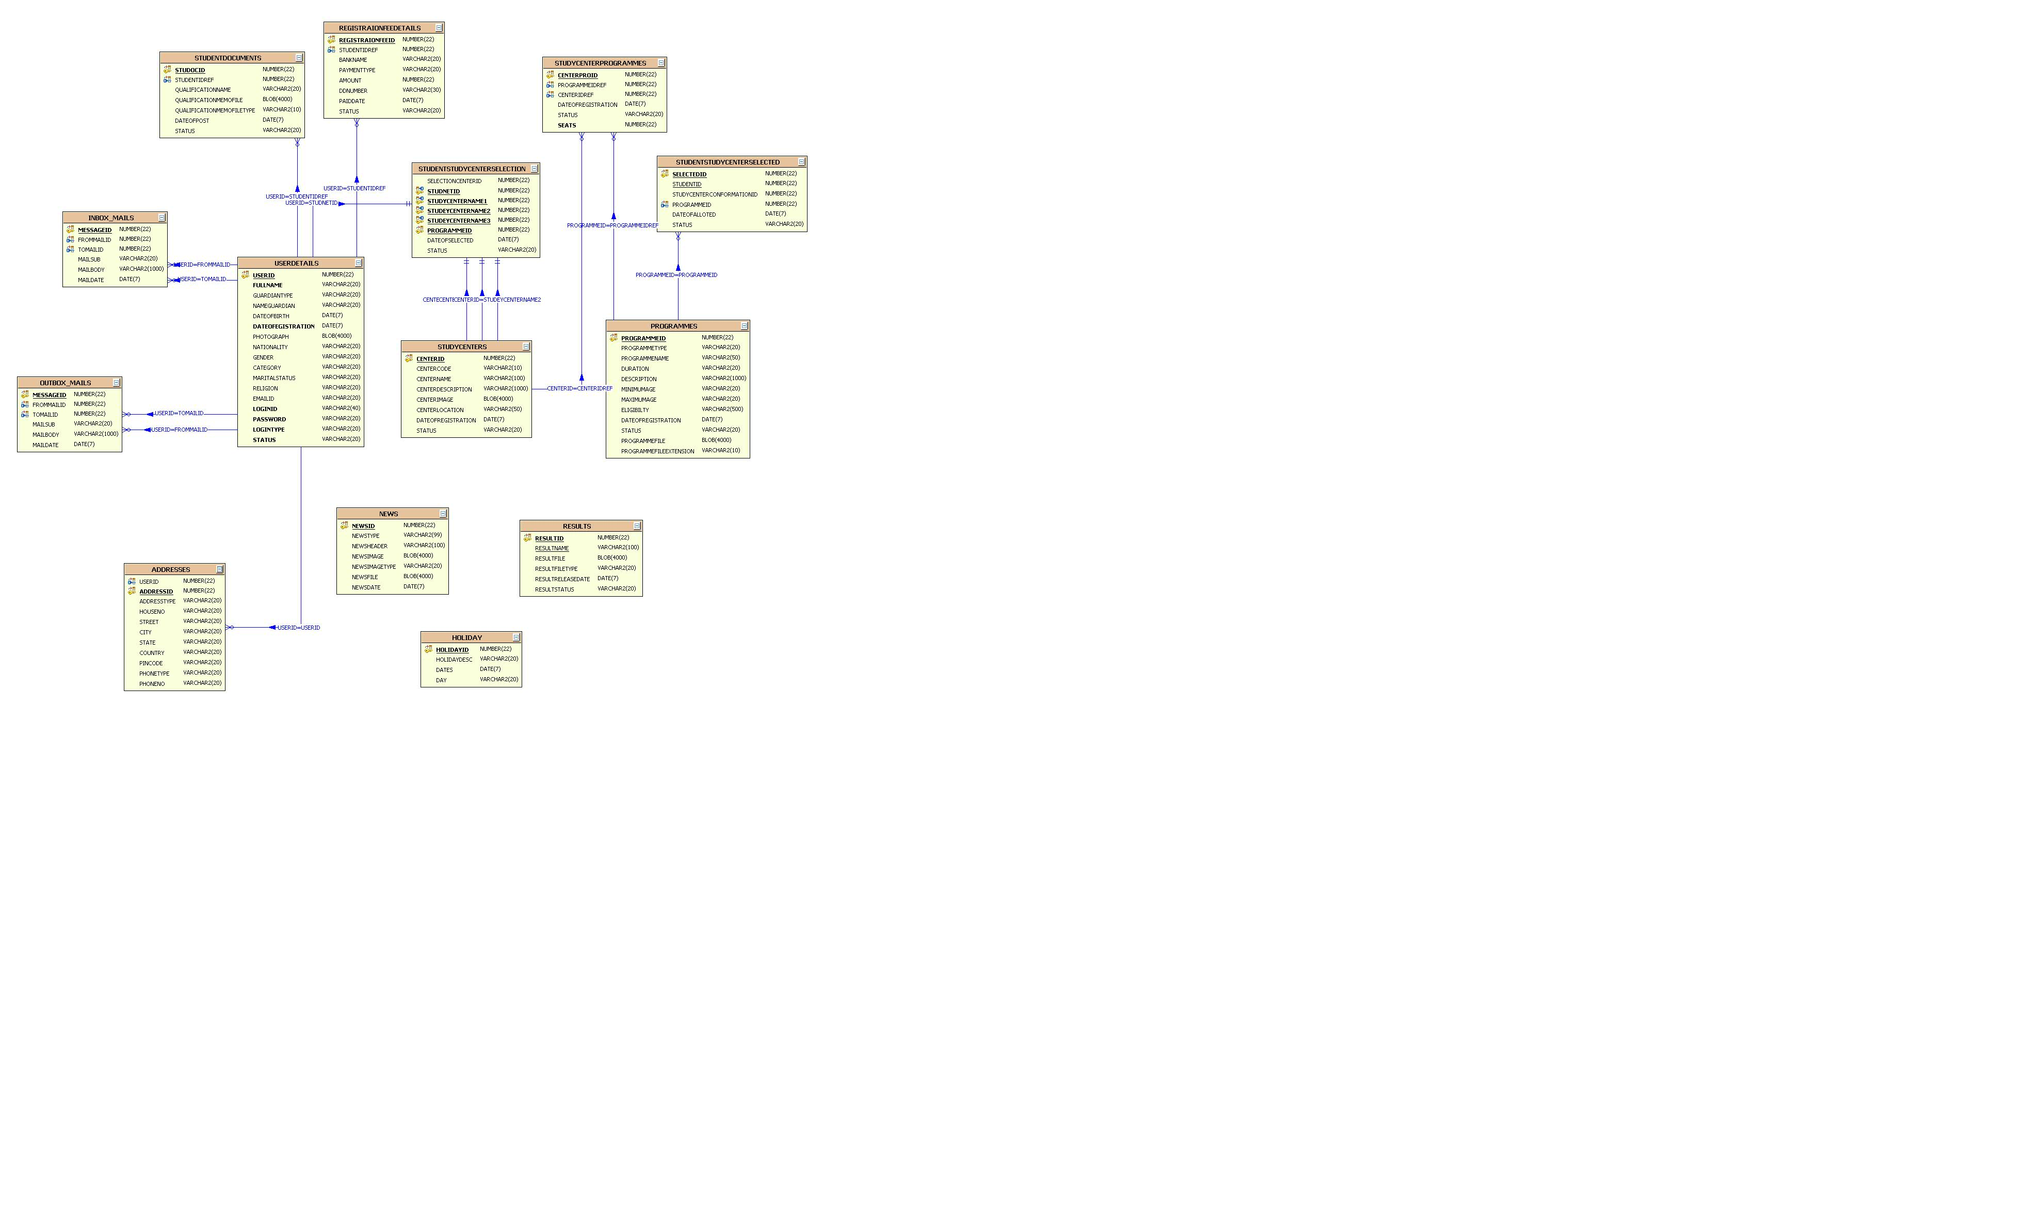
E-R Diagram

Slide 17
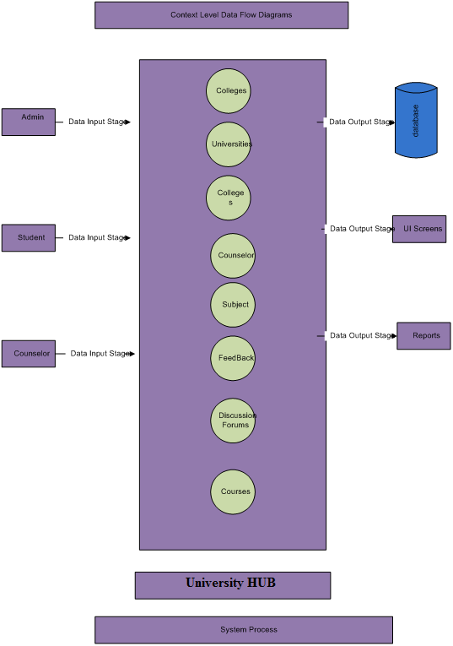
Context Level Diagram

Slide 18
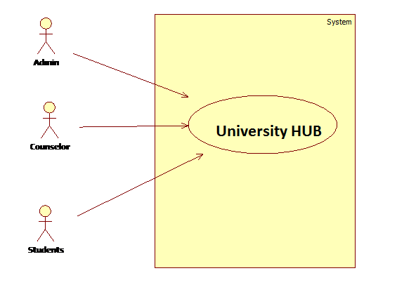
Use Case Diagram

Slide 19
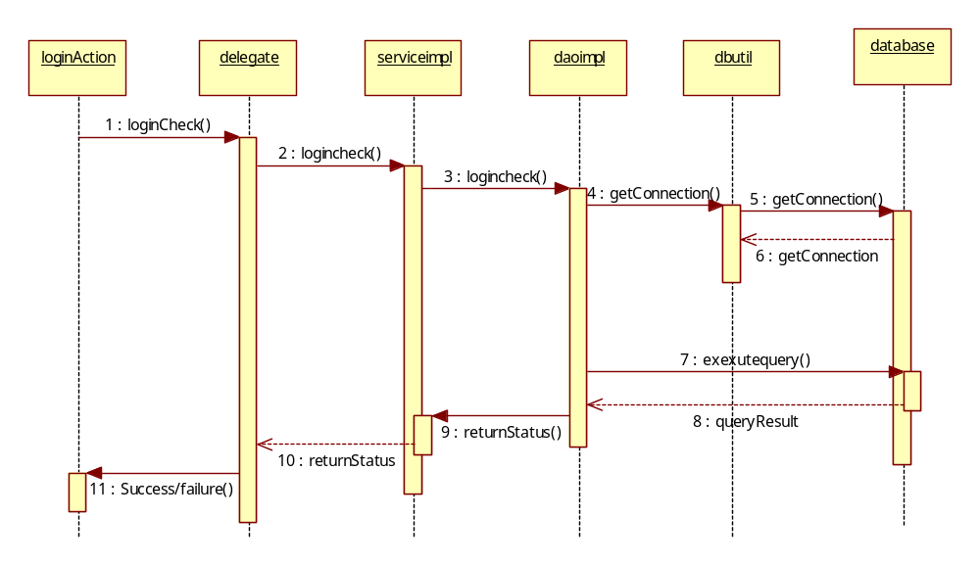
Sequence Diagrams

Slide 20
Conclusion
The OAS was successfully designed and is tested for accuracy and quality.
During this project we have accomplished all the objectives and this project meets the needs of the organization. The developed will be used in searching, retrieving and generating information for the concerned requests.
GOALS
  Reduced entry work
  Easy retrieval of information
  Reduced errors due to human intervention
  User friendly screens to enter the data
  Portable and flexible for further enhancement
  Web enabled.

Slide 21
Future Enhancements
University can approach to the geographically scattered students.
Trace all of the University Courses and the seats in each college falls under the University.
Common interface on web accessed by everyone.
Online admission forms along with online submission and online payment.
Central database having all information about candidates, colleges, courses..
Results details & verifications of filled forms for eligibility checking through online contact with Universities/Boards.
Preparation of merit list for each category and each course.

Slide 22
Bibliography
(1) Java Complete Reference by Herbert Shield
(2) Database Programming with JDBC and Java by George Reese
(3) Java and XML By Brett McLaughlin
(4) Wikipedia, URL: http://www.wikipedia.org.
(5) Answers.com, Online Dictionary, Encyclopedia and much more, URL: http://www.answers.com
(6) Google, URL: http://www.google.co.in
(7) The Complete Refernce Struts James Holmes
Struts: The Complete Reference, 2nd Edition - Free PDF Ebooks Download

Slide 23
Thank you!

